Slide 1
THE SPARKS FOUNDATION
INTERNSHIP {GRIP}
TASK 1 : RECRUITMENT ARTICLE AND POSTS
(HUMAN RESOURCES)
BY : AYESHA SHAHANAZ

Slide 2

UNDERSTANDING RECRUITMENT :
Recruitment is a core function of the Human Resource department. It is a process that involves everything from identifying, attracting, screening, short listing, interviewing, selecting, hiring, and on boarding employees.
The recruitment teams can be large or small depending on the size of an organization. However, in smaller organizations, recruitment is typically the responsibility of a recruiting manager.

Slide 3
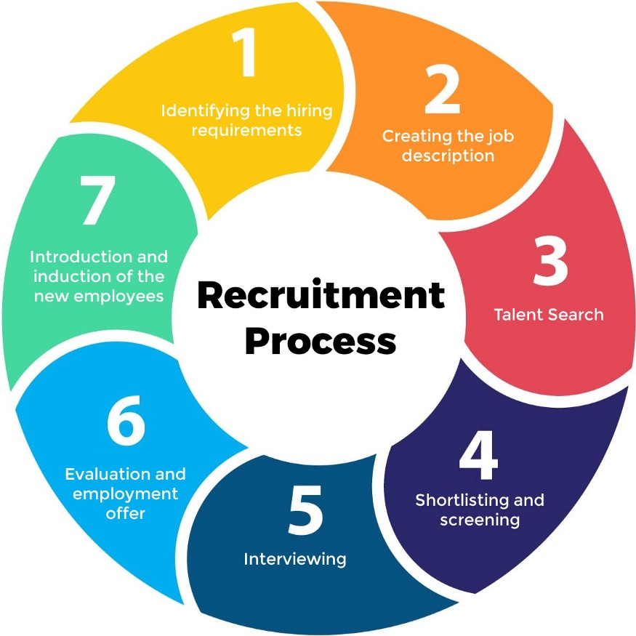
SOURCES OF RECRUITING :

Slide 4

REFERRALS FROM LINKEDIN :

Slide 5
STEPS TO GET REFERRALS
FROM LINKEDIN :
The basic steps to get successful referrals through LinkedIn are:
1. Expand your network and connect with as many people as you can.
2. Find the best-suited person.
3. Send the right formal message.
4. Keep the message informative — send your message with the right ID and URL of the opening (from the company career page, LinkedIn, etc.)
5. Create a template. Following a proper template of the referral message including your skills and relevant experience.
6. Be genuine with words.
7. Follow Up.

Slide 6

STEPS AND PLAN FOR RECRUITMENT USING SOCIAL MEDIA :
A job posting is used to advertise jobs and help standardize them across a business. a good template should least things that attract great candidates, instead of merely listing pertinent requirements and qualifications. Job postings are also called job advertisements, announcements, job ads or wanted ads.

Slide 7
SOCIAL MEDIA RECRUITMENT :
Recruiting has drastically changed in the past decade. Businesses are rapidly growing their workforce in an increasingly competitive landscape. The job market is changing. Not only are companies looking for new skill sets and abilities, but the way that companies find their ideal candidates has been turned on its head also. Social recruiting refers to the method of recruiting candidates through social media platforms, like LinkedIn, Face book, and Twitter, and other websites, including online forums, job boards, and blogs. Social recruiting is also stated as social media recruiting and social hiring.

Slide 8
Thank you!

